Slide 1
Spring 3 MVC
Spring 3.0 MVC Introduction
LEVEL – PRACTITIONER

Slide 2
Pritha Lahiri (211467)
5+ Years of experience in Java/J2EE
1.0, 7th December 2011

Slide 3


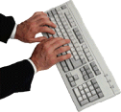






Icons Used
Hands on Exercise
Questions
Tools
Coding Standards
Test Your Understanding
Case Study
Best Practices & Industry Standards
Demonstration
Workshop

Slide 4
Context Setting: Overview
Introduction:
What is MVC?
Model-View-Controller (MVC) architecture separates core business model functionality from the presentation and control logic that uses this functionality.
Such separation allows multiple views to share the same enterprise data model, which makes supporting multiple clients easier to implement, test, and maintain.

Slide 5
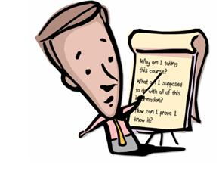
Objectives
After completing this chapter, you will be able to:
Explain the Spring MVC architecture.
Configure Dispatcher Servlet in web.xml.

Slide 6

Do you know?
What is MVC?

Slide 7

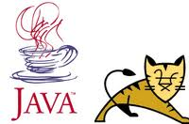

Resources
The resources required for this training are:
SDE 6
Java 1.5/1.6
Spring Framework 3.0
Apache Tomcat 6.0

Slide 8
MVC Architecture Diagram
The MVC Architecture is as follows:
Model
Business Logic
Get State
Set State
Update Event
Change View
View
Model Representation
Controller
User interaction
User Actions
Notes:
The MVC Architecture is as follows:
Model encapsulates the core data and functionality
View encapsulates the presentation of the data. There can be many views for the common data.
Controller accepts requests and makes requests from the model for the data to produce a new view.

Slide 9

Example of MVC Framework
Name some famous MVC Framework.
Notes:
Struts is an open source web application development framework. It is Based on the Model-View-Controller (MVC) design paradigm.
Java Server Faces (JSF) is a server side user interface component framework for Java™
technology-based web applications. It is Based on the Model-View-Controller (MVC) design paradigm.
Webwork is a Java web-application development framework. It is provides robust support for building reusable UI templates, such as form controls, UI themes, internationalization, dynamic form parameter mapping to JavaBeans, robust client and server side validation, and much more.

Slide 10
Life before MVC: Servlets
Servlets ruled the world before MVC pattern came.
They were faster than CGI programs.
They were more scalable with built-in threading capability.
It's value-added features include:
Request/Response, Sessions
Full Java API access
JDBC, JMS, EJB, Java Mail, and so on

Slide 11
Problems with Servlets
Some of the problems with Servlets are:
out.println in the code became tedious.
difficult for enhancement and maintenance
It takes a programmer to write HTML pages.
Skill mismatch
There has to be a better way.

Slide 12
Then Came the JSPs
Issues with JSPs:
Page-centric view of the world
Limited programmer involvement
JSPs became ubiquitous for dynamic HTML page generation

Slide 13
MVC Model 1 Architecture
Java Beans
EJB
Browser
JSP
Database
Custom Tags

Slide 14
MVC Model 1 Architecture (Contd.)
The feature of MVC Model 1 Architecture are as follows:
It is JSP centric.
It is sutiable for small systems.
It is susceptible to abuse due to the following reasons:
Excessive Java code in JSPs
Flow control issues

Slide 15
MVC Model 2 Architecture
The feature of MVC Model 2 Architecture are as follows:
It uses servlet for flow control and JSPs for HTML pages and dynamic content.
It allows programmer/Web designer specialization.
MVC comprises three components:
Controller : Servlet + Helper classes
Model: Application data/Operation
View: Output rendered to user

Slide 16
MVC Control Flow
Though MVC comes in different flavors, the control flow generally works as follows:
The user interacts with the user interface in some way (For example, user presses a button).
A controller handles the input event from the user interface, often via a registered handler or callback.
The controller accesses the model, possibly updating it in a way appropriate to the user’s action (For example, controller updates user’s shopping cart). Complex controllers are often structured using the command pattern to encapsulate actions and simplify extension.

Slide 17
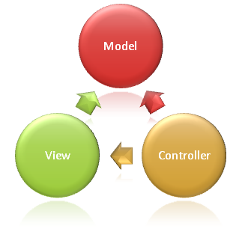
MVC Control Flow (Contd.)
A view uses the model to generate an appropriate user interface (For example, view produces a screen listing the shopping cart contents). The view gets its own data from the model. The model has no direct knowledge of the view.
The user interface waits for further user interactions, which begins the cycle anew.

Slide 18
Spring MVC Introduction
Spring MVC Introduction:
Spring's web MVC framework is request-driven, designed around a central servlet that dispatches requests to controllers and offers other functionality that facilitates the development of web applications.
There is clear separation of roles. Each role, controller, validator, command object, form object, model object.
Simplification of testing through Dependency Injection.
Reusable business code, no need for duplication. Use existing business objects as command or form objects instead of mirroring them to extend a particular framework base class.
Spring MVC supports JSP, FreeMarker, Velocity, XSLT, JasperReports, Excel and PDF views

Slide 19
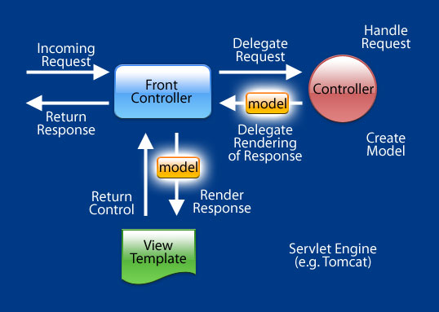
Request Life Cycle in Spring MVC
Requesting processing workflow in Spring Web MVC

Slide 20
Request Life Cycle in Spring MVC (Contd.)
When a request is sent to the Spring MVC Framework, the following sequence of events happen:
The Dispatcher Servlet first receives the request.
The Dispatcher Servlet consults the HandlerMapping and invokes the Controller associated with the request.
The Controller process the request by calling the appropriate service methods and returns a ModeAndView object to the DispatcherServlet. The ModeAndView object contains the model data and the view name.
The DispatcherServlet sends the view name to a ViewResolver to find the actual View to invoke.
Now the DispatcherServlet will pass the model object to the View to render the result.
The View with the help of the model data will render the result back to the user.

Slide 21

Comparison with Struts 1.x
In Spring Web MVC you can use any object as a command or form-backing object; you do not need to implement a framework-specific interface or base class, unlike Struts, which forces your Action and Form objects into concrete inheritance.
Spring's data binding is highly flexible. For example, it treats type mismatches as validation errors that can be evaluated by the application, not as system errors. Thus you need not duplicate your business objects' properties as simple, untyped strings in your form objects simply to handle invalid submissions, or to convert the Strings properly. Instead, it is often preferable to bind directly to your business objects/domain objects.

Slide 22
Introduction to Dispatcher Servlet
1. Looks up handler
Handler Mapping
Request
2. Dispatches to Controller through
interceptors
Controller
3. Returns ModelandView through
interceptors
Interceptors
DispatchServlet
4. Looks up handler
ViewResolver
Response
5. Delegates Rendering
View

Slide 23
Dispatcher Servlet
The Spring Web model-view-controller (MVC) framework is designed around a Dispatcher Servlet that dispatches requests to handlers, with configurable handler mappings, view resolution, locale and theme resolution as well as support for uploading files.
Example of Front Controller pattern - entry point for all Spring MVC requests.
Dispatcher Servlet inherits from the HttpServlet base class.
Dispatcher Servlet has its own WebApplicationContext, which inherits all the beans already defined in the root WebApplicationContext.

Slide 24
Web.xml
Dispatcher Servlet configuration in web.xml
<web-app> <servlet> <servlet-name>example</servlet-name> <servlet-class> org.springframework.web.servlet.DispatcherServlet </servlet-class> <load-on-startup>1</load-on-startup> </servlet> <servlet-mapping> <servlet-name>example</servlet-name> <url-pattern>*.do</url-pattern> </servlet-mapping> </web-app>

Slide 25
Dispatcher Servlet
Note that the *.do url pattern has been mapped with example DispatcherServlet. Thus any url with *.do pattern calls Spring MVC Front controller.
Upon initialization of a Dispatcher Servlet, the framework looks for a file named [servlet-name]-servlet.xml in the WEB-INF directory of your web application and creates the beans defined there.
As per previous configuration of dispatcher servlet ,framework looks for example-servlet.xml in the WEB-INF directory. This file contains all Spring MVC specific beans.

Slide 26
Web.xml
Application context configuration in web.xml
<web-app> <context-param> <param-name>contextConfigLocation</param-name> <param-value> /WEB-INF/service.xml </param-value> </context-param> <listener> <listener-class> org.springframework.web.context.ContextLoaderListener </listener-class> </listener> </web-app>

Slide 27
web.xml (Contd.)
Closing associated term with the Dispatcher Servlet is the Application Context. An Application Context usually represents a set of Configuration Files that are used to provide Configuration Information to the Application.
Application Context can be loaded declaratively within the context of an application server , and it is created via ContextLoaderListener.
By default, this Context Listener will try to look for the Configuration File by name 'applicationContext.xml' in the '/WEB-INF' directory. But with the help of the parameter 'contextConfigLocation' the default location can be overridden. Even multiple Configuration Files each containing separate piece of Information is also possible.

Slide 28
Two Applications Context
The parent context or Root ApplicationContext contains all of the non-web specific beans such as the services, DAOs and so on and it is created via ContextLoaderListener.
The WebApplicationContext is an extension of the plain Application Context that has some extra features necessary for web applications.
The WebApplicationContext is bound in the ServletContext, and by using static methods on the RequestContextUtils class you can always look up the WebApplicationContext.
The WebApplicationContext is nested inside the root ApplicationContext so that the web components can easily find their dependencies

Slide 29
Web Application Context
Take a look at the Special beans in the WebApplicationContext.
Bean Type | Explanation
Controllers | Form the C part of the MVC.
Handlers mappings | Handle the execution of a list of pre-processors and post-processors and controllers that will be executed if they match certain criteria (for example, a matching URL specified with the controller).
Validator | Spring 3 provides support for declarative validation with JSR-303. This support is enabled automatically if a JSR-303 provider, such as Hibernate Validator, is present on your classpath. When enabled, you can trigger validation simply by annotating a Controller method parameter with the @Valid annotation:
View Resolvers | Resolves view Names to views
Handler Exception resolvers | Contains functionality to map exceptions to views or implement other more complex exception handling code.

Slide 30
Web Application Context (Contd.)
Bean Type | Explanation
Locale Resolver | Most parts of Spring's architecture support internationalization, just as the Spring web MVC framework does. DispatcherServlet enables automatically resolve messages using the client's locale. This is done with LocaleResolver objects.
Theme Resolver | You can apply Spring Web MVC framework themes to set the overall look-and-feel of your application. A theme is a collection of static resources, typically style sheets and images, that affect the visual style of the application. To use themes in your web application, you must set up an implementation of the org.springframework.ui.context.ThemeSource interface.

Slide 31
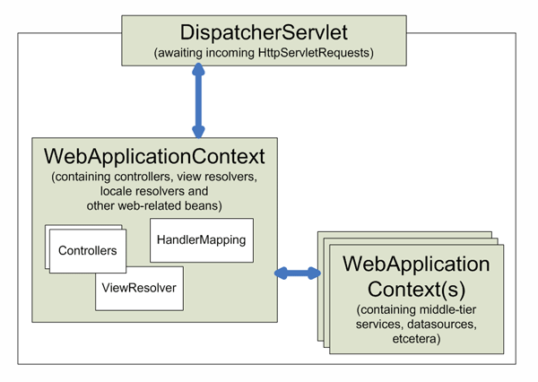
Context Hierarchy in Spring Web MVC
This diagram shows the context hierarchy in Spring Web MVC.

Slide 32
What is New in Spring 3 MVC
What is new in Spring 3 MVC:
Spring 3 introduces a mvc namespace that greatly simplifies Spring MVC setup.
Using the Spring 3 Type Conversion Service as a simpler and more robust alternative to JavaBeans PropertyEditors .
Support for formatting Number fields with @NumberFormat.
Support for formatting Date, Calendar, and Joda Time fields with @DateTimeFormat, if Joda Time is on the class path.
Support for validating @Controller inputs with @Valid, if a JSR-303 Provider is on the classpath.
Support for reading and writing XML, if JAXB is on the classpath.
Support for reading and writing JSON, if jackson is on the classpath.
Spring MVC 3 provides support Ajax remoting with JSON.

Slide 33
Questions

Slide 34

Welcome Break

Slide 35
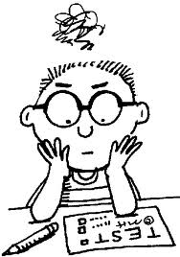
Test Your Understanding
Is Spring MVC a request-driven framework?
Yes
No
Notes:
Correct Answer: Yes.

Slide 36
Test Your Understanding
2. Which design pattern does Spring MVC follow?
Front Controller Pattern
Back Controller Pattern
Middle Controller Pattern
Notes:
Correct Answer: Front Controller Pattern.

Slide 37
Test Your Understanding
3. What is WebApplicationContext?
A special servlet that has some extra features necessary for web applications.
An extension of the plain Application Context that has some extra features necessary for web applications.
Notes:
Correct Answer: The WebApplicationContext is an extension of the plain Application Context that has some extra features necessary for web applications.

Slide 38

Summary
Let us take a quick look at the key points covere d in this chapter.
The Spring MVC is a web development framework based on the Model View Controller (MVC) design pattern. The features of Spring MVC Framework are the Pluggable View technology and Injection of services into controllers.
The Spring Web MVC framework is designed around a Dispatcher Servlet.
Spring MVC provides a very clean division between controllers, JavaBean models, and views.
Spring MVC supports JSP, FreeMarker, Velocity, XSLT, JasperReports, Excel and PDF views.

Slide 39


Source
http://www.springsource.org
http://blog.codebeach.com/2008/06/spring-mvc-application-architecture.html
“Expert Spring Web MVC and Web Flow” by Seth Ladd and others (published by Apress) is an excellent hard copy source of Spring Web MVC goodness.
Disclaimer: Parts of the content of this course is based on the materials available from the Web sites and books listed above. The materials that can be accessed from linked sites are not maintained by Cognizant Academy and we are not responsible for the contents thereof. All trademarks, service marks, and trade names in this course are the marks of the respective owner(s).

Slide 40
Spring 3 MVC
You have successfully completed -
Spring 3 MVC Introduction

